Slide 1

Computer Vision Project
Object detection

Slide 2
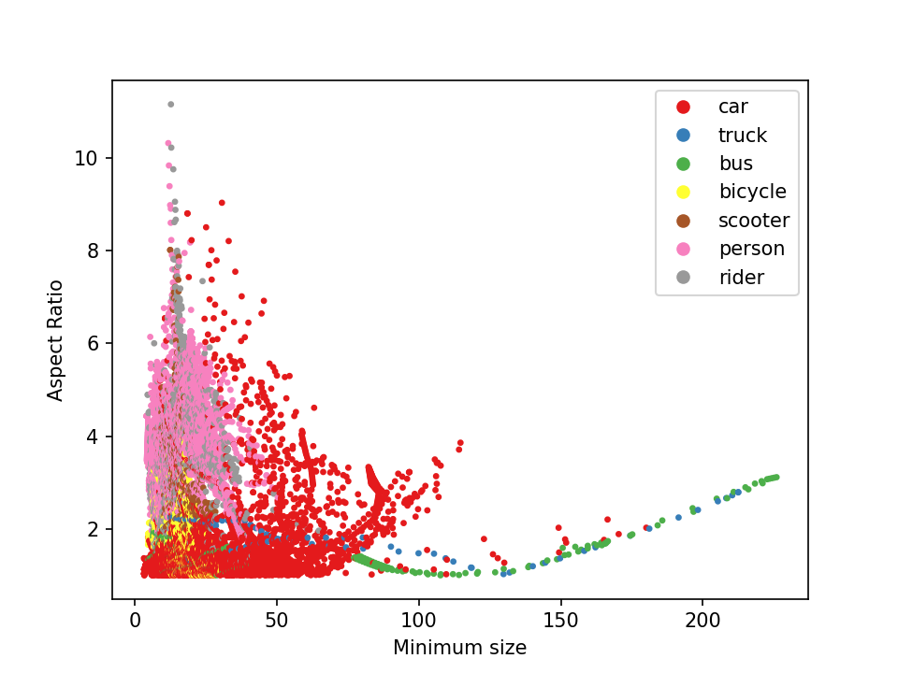
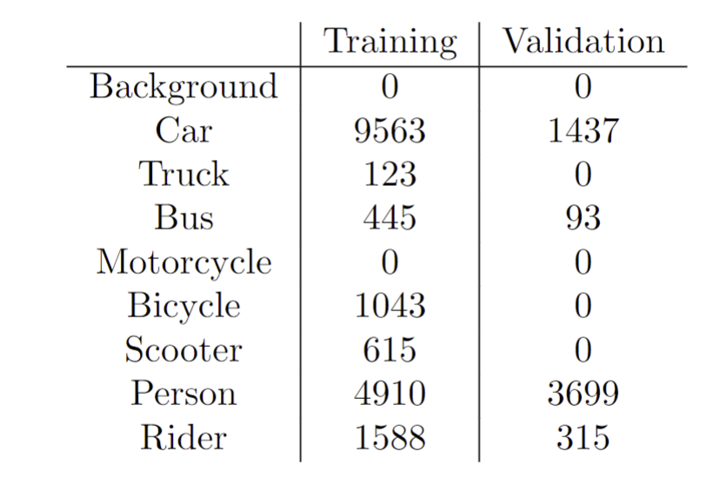
Dataset exploration
Very small and very large
Mostly background
Different quantity

Slide 3
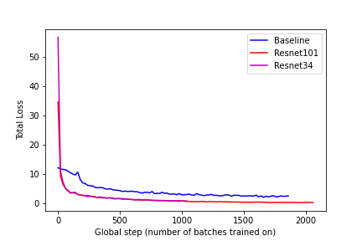
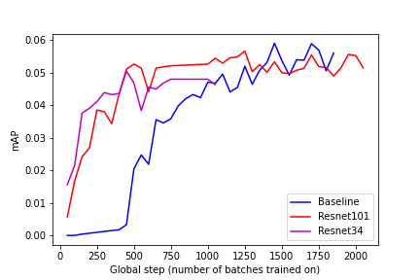
RetinaNet ResNet + FPN
Inference time to 4.3 FPS from 6.8 FPS

Slide 4
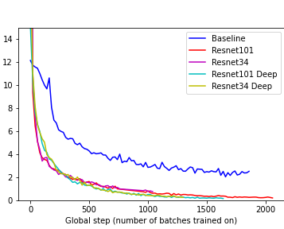
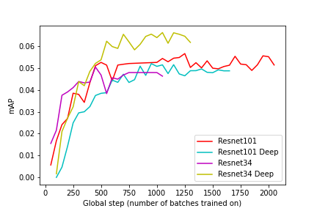
RetinaNet Deeper subnets
Inference speed 1.77 FPS

Slide 5
RetinaNet Parameter initiation

Slide 6
RetinaNet Focal Loss

Slide 7
Using exploration knowledge

Slide 8
Discussion and Qualitative Analysis

Slide 9
Final Discussion

